Slide 1
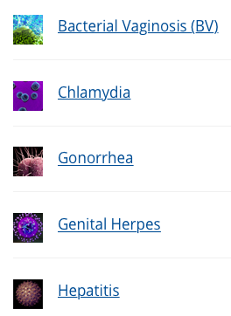
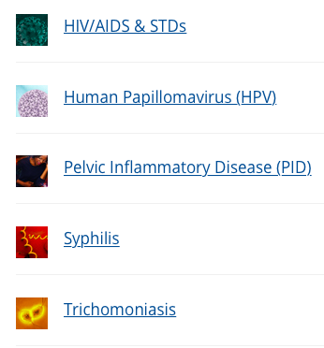
Sexually transmitted diseases
https://www.cdc.gov/std/default.htm
IGCSE Biology
Warning:
You may have no or mild symptoms sometimes, but some could cause severe, permanent damage to body.

Slide 2
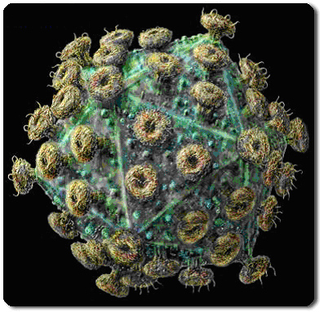
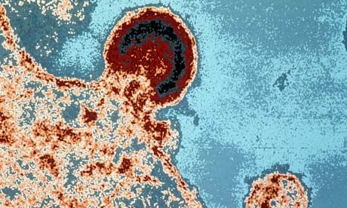
AIDS
https://hivrisk.cdc.gov/can-decrease-hiv-risk/?mid=pre-exposure-prophylaxis-prep-for-preventing-hiv-2631
This disease is caused by a virus – HIV (Human immunodeficiency virus).

Slide 3
AIDS - progression
Without medication, it may take years before HIV weakens your immune system to the point that you have AIDS.
Untreated, HIV typically turns into AIDS in about 10 years.
There's no cure for HIV/AIDS, but there are medications that can dramatically slow the progression of the disease.
HIV destroys CD4 T cells — white blood cells that play a large role in helping your body fight disease. The fewer CD4 T cells you have, the weaker your immune system becomes.

Slide 4
AIDS - progression
A person with HIV is considered to have progressed to AIDS when:
the number of their CD4 cells falls below 200 cells per cubic millimeter of blood (200 cells/mm³). (In someone with a healthy immune system, CD4 counts are between 500 and 1,600 cells/mm³.) OR
they develop one or more opportunistic infections regardless of their CD4 count.

Slide 5
AIDS - OI
Complication/ OI (opportunistic infection)
HIV infection weakens your immune system, making you much more likely to develop numerous infections and certain types of cancers.
E.g. Tuberculosis (TB) is the most common opportunistic infection associated with HIV. It's a leading cause of death among people with AIDS.
Others include pneumonia,

Slide 6
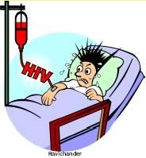
AIDS - tRANSMISSION
How is the virus transmitted?
HIV isn't spread through the air, water or insect bites.
Sexual intercourse with someone infected by the virus. The virus is carried in blood and semen.
Blood transfusions using blood containing the virus.
Injections with needles previously used by someone infected with the virus.
From an infected mother to baby (across the placenta during pregnancy, labor, delivery, or breastfeeding).

Slide 7
AIDS - RISKs
What activities can put me at risk for both STDs and HIV?
Having anal, vaginal, or oral sex without a condom;
Having multiple sex partners;
Having anonymous sex partners;
Having sex while under the influence of drugs or alcohol can lower inhibitions and result in greater sexual risk-taking.

Slide 8

AIDS - PREVENTION
How can the disease be prevented?
Using condoms and reducing the number of sexual partners.
Choose sexual activities with little to no risk, like oral sex.
Using clean, sterile needles for injections.
Testing (screening) blood used for transfusions.
HIV-negative partner take daily medicine to prevent HIV (called pre-exposure prophylaxis or PrEP)
Notes:
If you have a recent possible exposure to HIV, your doctor can prescribe the same medicines used for PrEP to reduce your chances of getting HIV. This is called post-exposure prophylaxis, or PEP.

Slide 9
AIDS – wHAT CAN YOU DO
If you learn that you have HIV, the most important thing you can do is to take ART ( antiretroviral therapy) as prescribed.
ART is recommended for all people with HIV, regardless of how long they’ve had the virus or how healthy they are. ART can reduce the amount of HIV (viral load) in your body. Taking ART as prescribed can make your viral load so low that a test can’t detect it. This is called an undetectable viral load.
If you get and keep an undetectable viral load, you can stay healthy for many years and have effectively no risk of transmitting HIV through sex. The sooner you start taking ART, the more effective it will be at improving your health and preventing transmission to your baby.

Slide 10
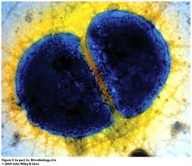
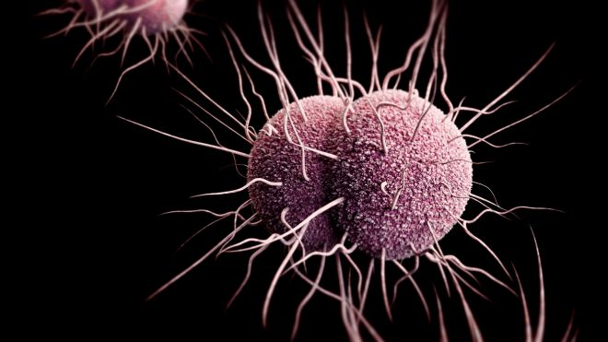

Gonorrhoea
This disease is caused by bacteria and spread by sexual intercourse.
Neisseria gonorrhoeae

Slide 11
Gonorrhoea
Symptoms in men:
It can cause a sore on the penis, inflammation of the urethra, pain when urinating and a yellow-green discharge from the penis.
The infection can also cause blockage of the sperm duct, which can lead to infertility.
It can also lead to infection of the prostate gland and difficulty in urinating.

Slide 12
Gonorrhoea
Symptoms in women.
There can often be no symptoms, though there may be a discharge from the vagina.
The infection may spread to the oviducts (Fallopian tubes), where it can cause fever and pain, and can lead to infertility.

Slide 13
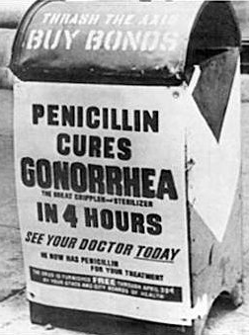
Gonorrhoea
Treatment:
The disease can be treated with antibiotics, e.g. penicillin.
Using condoms and reducing the number of sexual partners can prevent the disease.

